Slide 1
Roslyn Analyzers and Real World Code clones and disposing and oh my…
Joe Healy – Microsoft – Tampa, FL
Cloud Solution Architect
jhealy@microsoft.com

Slide 2

“The Horror, the Horror.”

Slide 3

Hi, I used Roslyn Analyzers to find this bug. And I’m sooo happy!

Slide 4
WARNING
The following presentation contains real code snippets from customer project
Namespaces and functionality may have been changed to protect the guilty
If you are a coding purist leave now
If you are on the C# team leave now
If you were a “software craftsman” leave now
Notes:
Code Clone Analysis Tool in Visual Studio – Gowtham K (gowthamcbe.com) https://gowthamcbe.com/2020/05/14/code-clone-analysis-tool-in-visual-studio/

Slide 5

Code Clone Analysis

Slide 6
Code Clone Analysis
Requires Enterprise Edition
Fragments of code that are exact or similar across a solution
Common across apps that have been hurried or evolved over time
Create difficulties in maintenance
Good items to refactor

Slide 7
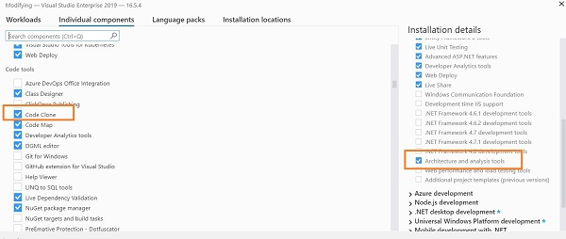
Installation
Under Visual Studio Installer

Slide 8
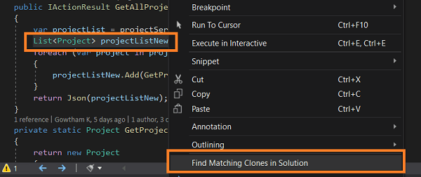
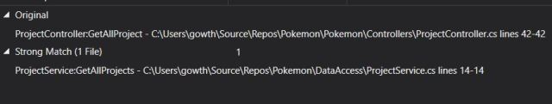
Single line analysis
Select line
Right mouse
Find matching clones in solution

Slide 9
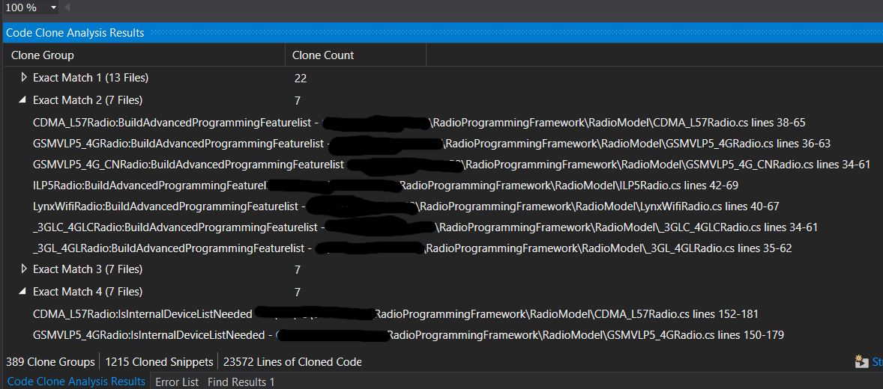
Solution Level Analysis
Analyze > Analyze Solution for Code Clones
May require a “clean” of solution
Can take a while. Coffee/tea break recommended.

Slide 10
CultureInfo
22 clones, 13 files – some clones inside the same file
string[] languages = Request.UserLanguages;
if (languages.Count() > 0)
{
try
{
cultreInfo = new CultureInfo(languages[0]);
}
catch (CultureNotFoundException)
{
cultreInfo = CultureInfo.InvariantCulture;
}
}
else
cultreInfo = CultureInfo.InvariantCulture;
Web > EnumerableProofs.cs

Slide 11
RadioModel
7 clones
AdvancedDeviceProgrammingFeaturesList = new List<IFeature>();
AdvancedDeviceProgrammingFeaturesList.Add(_featuresFactory.CreateSupervisionFeature());
AdvancedDeviceProgrammingFeaturesList.Add(_featuresFactory.CreateLocalProgrammingFeature());
AdvancedDeviceProgrammingFeaturesList.Add(_featuresFactory.CreateOldAlarmTimeFeature());
AdvancedDeviceProgrammingFeaturesList.Add(_featuresFactory.CreateTwoWayVoiceFeature());
AdvancedDeviceProgrammingFeaturesList.Add(_featuresFactory.CreateHighUsagePlanFeature());
AdvancedDeviceProgrammingFeaturesList.Add(_featuresFactory.CreateInternalDeviceFeature());
AdvancedDeviceProgrammingFeaturesList.Add(_featuresFactory.CreateUL864CommercialFireFeature());
AdvancedDeviceProgrammingFeaturesList.Add(_featuresFactory.CreateBellOutConnectFeature());
dvancedDeviceProgrammingFeaturesList.Add(_featuresFactory.CreateDirectWireAddressFeature());
AdvancedDeviceProgrammingFeaturesList.Add(_featuresFactory.CreateFaultRelayFeature());
AdvancedDeviceProgrammingFeaturesList.Add(_featuresFactory.CreateAPLFeature());
AdvancedDeviceProgrammingFeaturesList.Add(_featuresFactory.CreateCompassOverWirelessFeature());
AdvancedDeviceProgrammingFeaturesList.Add(_featuresFactory.CreateECPAddressFeature());
AdvancedDeviceProgrammingFeaturesList.Add(_featuresFactory.CreateIPConnectionFeature());
AdvancedDeviceProgrammingFeaturesList.Add(_featuresFactory.CreateGSMSupervisionRollOverFeature());
AdvancedDeviceProgrammingFeaturesList.Add(_featuresFactory.CreateIcontrolFeature());
AdvancedDeviceProgrammingFeaturesList.Add(_featuresFactory.CreateZonesFeature());
AdvancedDeviceProgrammingFeaturesList.Add(_featuresFactory.CreateRemoteServicesFeature());
AdvancedDeviceProgrammingFeaturesList.Add(_featuresFactory.CreateKeyPadTypeFeature());
AdvancedDeviceProgrammingFeaturesList.Add(_featuresFactory.CreateMultiPartitionFeature());
AdvancedDeviceProgrammingFeaturesList.Add(_featuresFactory.CreateMultiModeFeature());
AdvancedDeviceProgrammingFeaturesList.Add(_featuresFactory.CreateMultiModeAddressFeature());
AdvancedDeviceProgrammingFeaturesList.Add(_featuresFactory.CreateEthernetPowerSaveFeature());

Slide 12
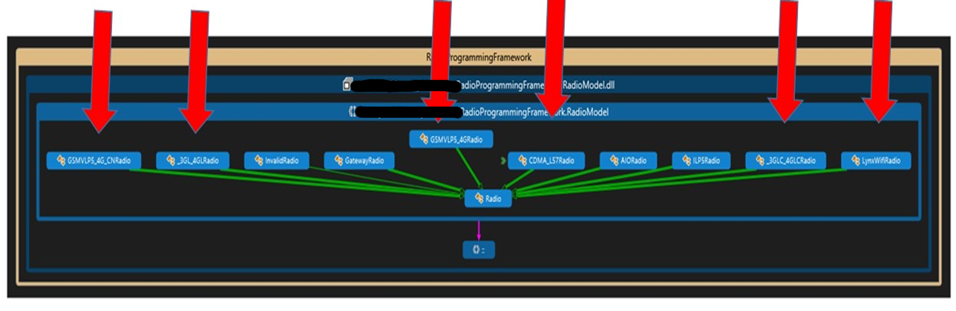
RadioModel Cloned in all these classes
7 clones

Slide 13
Same Code, Same File
AccountManagementController.cs in lines 1078-1092, as well as 1171-1185
CommProgrammingController.cs, lines 83-878 as well as 888-902
private CommunicatorDetailModel GetCommunicatorDetails(Account account)
{
CommunicatorDetailModel commDetail = new CommunicatorDetailModel();
string[] languages = Request.UserLanguages;
if (languages.Count() > 0)
{
try
{
cultreInfo = new CultureInfo(languages[0]);
}
catch (CultureNotFoundException)
{
cultreInfo = CultureInfo.InvariantCulture;
}
}
else
cultreInfo = CultureInfo.InvariantCulture;
private CommunicatorDetailModel GetCommunicatorDetails(Account account)
{
CommunicatorDetailModel commDetail = new CommunicatorDetailModel();
string[] languages = Request.UserLanguages;
if (languages.Count() > 0)
{
try
{
cultreInfo = new CultureInfo(languages[0]);
}
catch (CultureNotFoundException)
{
cultreInfo = CultureInfo.InvariantCulture;
}
}
else
cultreInfo = CultureInfo.InvariantCulture;

Slide 14
ValidateEmailRegEx
Can anyone tell me the RegEx to validate an email?

Slide 15
ValidateEmail RegEx
Reproduced 3 times. Not trivial client custom logic
bool retVal = false;
// regex source msdn.microsoft.com/en-us/library/01escwtf.aspx
// updated regex per RFC 2822 to include "/" and "_"
// exclude "&" to prevent appending of "amp" from flash, "&" is part of RFC 2822
// special characters currently allowed . @ ! # $ % ' * + - / = ? ^ _ ` { | } ~
string expr = @"^(?("")("".+?""@)|(([0-9a-zA-Z-!#\$%/_'\*\+/=\?\^`\{\}\|~]((\.(?!\.))" +
@"|[-!#\$%/_'\*\+/=\?\^`\{\}\|~\w])*)(?<=[0-9a-zA-Z-!#\$%/_'\*\+/=\?\^`\{\}\|~])@))" +
@"(?(\[)(\[(\d{1,3}\.){3}\d{1,3}\])|(([0-9a-zA-Z][-\w]*[0-9a-zA-Z]*\.)+[a-zA-Z]{2,6}))$";
Regex emailExpr = new Regex(expr);
string expr1 = @"^.{6,255}$";
Regex emailExpr1 = new Regex(expr1);
if (!String.IsNullOrEmpty(email.Trim()))
{
//EmailAddress validation
if (emailExpr.IsMatch(email.Trim()) && emailExpr1.IsMatch(email.Trim()))
{
retVal = true;
}
else
{
retVal = false;
}
}
return retVal;

Slide 16
Cloned Code Analysis
DEMO

Slide 17
Portability Analyzer for .NET Core

Slide 18
Portabililty Analyzer
Install from Extensions and Updates
Excel report on how ready your code is

Slide 19
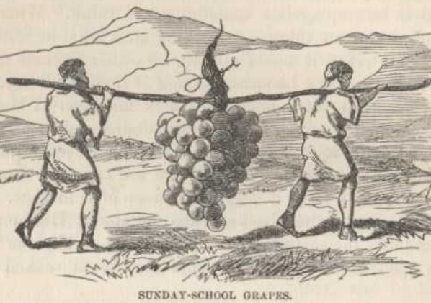
Portability Analyzer
DEMO

Slide 20
Live Static Code Analysis

Slide 21
Live Static Code Analyzer
Live – as you work – Roslyn brought LIVE
IN YOUR FACE warnings and errors
Improve coding skills while devs work
Work against “rules”

Slide 22
DEMO: Analyzers in Action

Slide 23
Enabling core analyzers
Pre-VS2019 16.8 and/or < .NET 5.0
Install Microsoft.CodeAnalysis.NetAnalyzers Nuget
VS2019 16.8 and/or > .NET 5.0
VS 2019 16.8 and .NET 5.0> analyzers included with .NET SDK.
Set MSBuild EnableNETAnalyzers=true
<PropertyGroup> <EnableNETAnalyzers>true</EnableNETAnalyzers>
</PropertyGroup>
Notes:
https://docs.microsoft.com/en-us/visualstudio/code-quality/install-net-analyzers?view=vs-2019

Slide 24
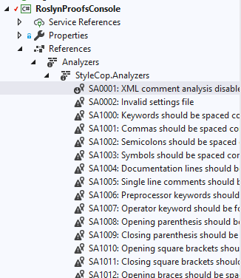
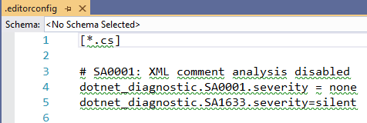
3rd Party Analyzers
Nuget
Install package into project using Visual Studio or Package Manager
Solutions Explorer -> References > Analyzers
Adjust rules in IDE to build out rulesets (.editorconfig)

Slide 25
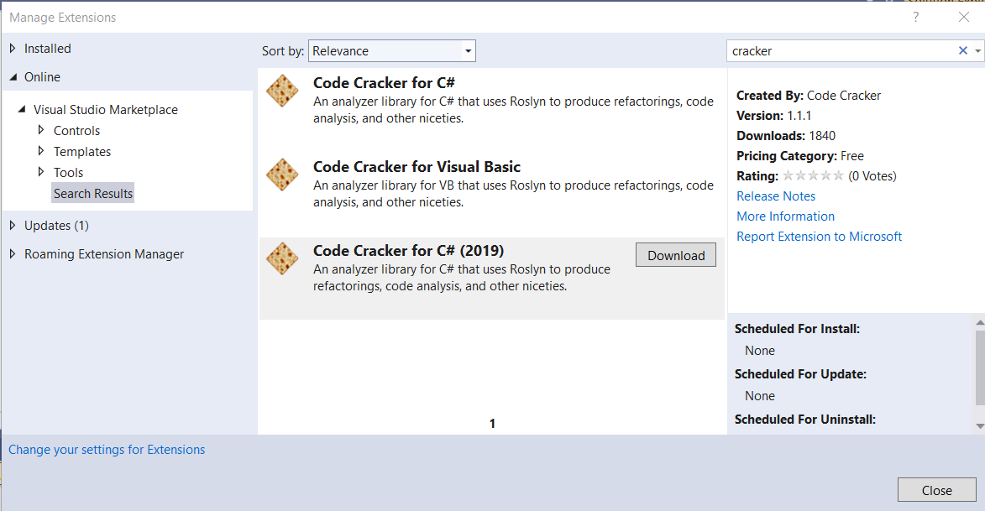
3rd Party Analyzers
VSIX
Install from extensions manager
Extensions > Manage Extensions

Slide 26
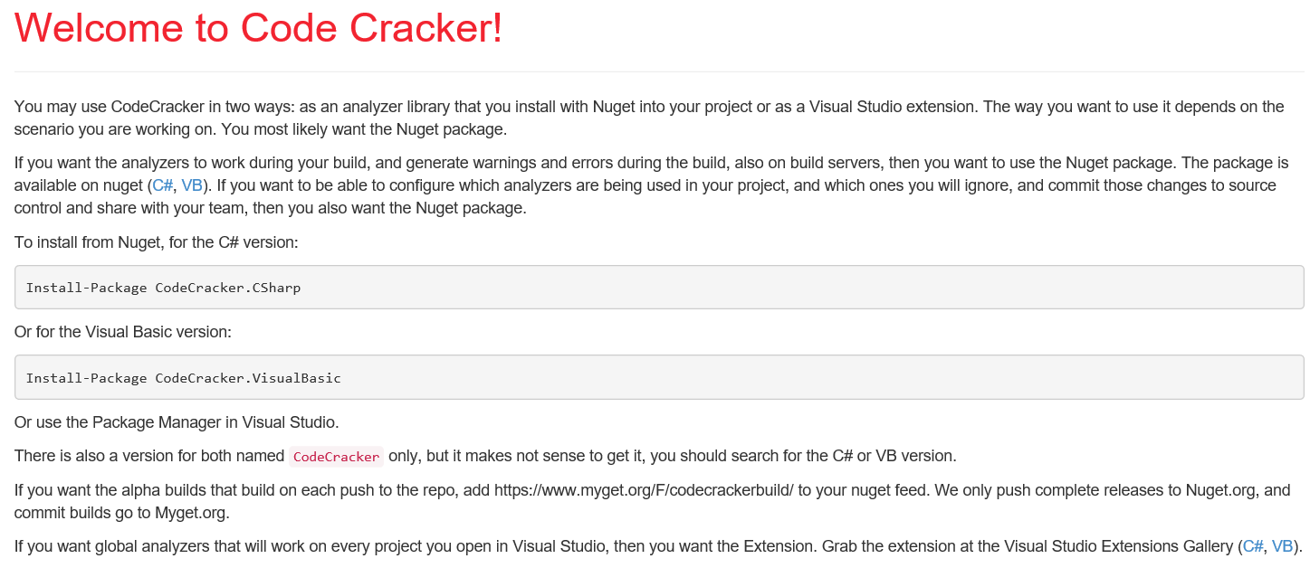
Code Cracker for C#
Open source
Good value showdn with empty catch blocks, improper IDisposable usage and patterns, performance gains through static methods, improper usage of XML comments….
Remove following rules from RuleSet to reduce "noise"
CC0001 - Var Instead of Type Name - debatable
CC0003 - currently implemented pattern works, not worth time at this point
CC0008 - You can use initializers in here - debatable
CC0015 - Remove unnecessary parenthesis. - style issue, debatable
CC0037 - Commented code should be removed
CC0065 - Remove trailing whitespace
CC0105 - Use 'var' instead of specifying the type name – debatable
https://github.com/code-cracker

Slide 27
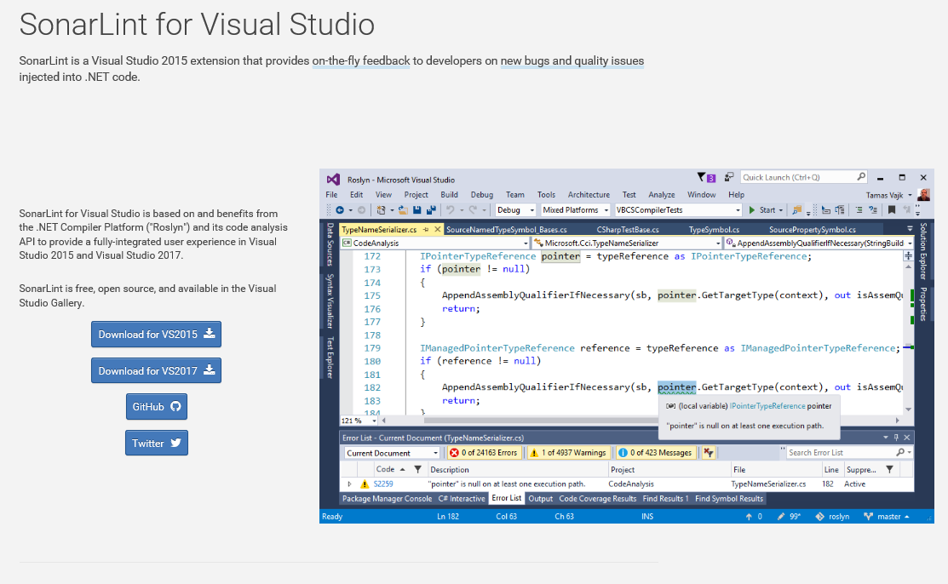
SonarAnalyzer.CSharp nuget
Open source
unused code, empty methods, globalization, unused variables, string anti-patterns, unused but assigned local variables, property anti-patterns, and empty exception blocks
Remove following rules from base SonarLint RuleSet to reduce "noise"
S100 - Rename method to match camel case
S125 - Remove commented out code
S1450 - Remove the {fieldname} field and declare it as a local variable in the relevant methods.
S2360 - Use the overloading mechanism instead of the optional parameters.
S2933 - Make "_log" "readonly"
Version 2.0 allows a connection to a SonarQube server. Bind your Visual Studio solution to a SonarQube project. Automatically updates the rulesets of the solution and attaches the required Roslyn analyzers to the solution.
http://www.sonarlint.org/visualstudio/index.html

Slide 28
Explore Various Analyzer Packs
Wintellect Analyzers - https://github.com/Wintellect/Wintellect.Analyzers
Roslyn Security Guard - https://dotnet-security-guard.github.io

Slide 29






Running the Rules
Eh? I turned them off, there were too many of them!
They were all code styling things….

Slide 30
Dump to File
IDE is great
How to push to a file in msbuild?
msbuild.exe .\RoslynProofs\RoslynProofs.sln /p:RunCodeAnalysis=True /t:rebuild
Using shared compilation with compiler from directory: C:\Program Files (x86)\MSBuild\14.0\bin
LogUtils.cs(13,23): warning CS0108: 'LoggerBase.Name' hides inherited member 'EventSource.Name'. Use the new keyword if hiding was intended. [C:\dev\RoslynProofsGit\RoslynProofs\RoslynProofsConsole\RoslynProofsConsole.csproj]
ProfileHelpers.cs(75,17): warning CS0472: The result of the expression is always 'true' since a value of type 'CanProfile' is never equal to 'null' of type 'CanProfile?' [C:\dev\RoslynProofsGit\RoslynProofs\RoslynProofsConsole\RoslynProofsConsole.csproj]
ResourceHelpers.cs(38,33): warning CS0649: Field 'ResourceHelpers.CustomResourceReader._resources' is never assigned to, and will always have its default value null [C:\dev\RoslynProofsGit\RoslynProofs\RoslynProofsConsole\RoslynProofsConsole.csproj]
ResourceHelpers.cs(40,32): warning CS0169: The field 'ResourceHelpers.CustomResourceReader.manager' is never used [C:\dev\RoslynProofsGit\RoslynProofs\RoslynProofsConsole\RoslynProofsConsole.csproj]
animals\People.cs(12,16): warning CS0414: The field 'People.RequiredFieldErrorMessage' is assigned but its value is never used [C:\dev\RoslynProofsGit\RoslynProofs\RoslynProofsConsole\RoslynProofsConsole.csproj]
animals\People.cs(13,16): warning CS0414: The field 'People.DateFieldErrorMessage' is assigned but its value is never used

Slide 31
Rule and Analysis Demo
DEMO

Slide 32

Overview of Violations
Imported to Excel ( tricky with large numbers of warnings )
Removed Internationalization
Remove most style violations
Graded violations low, medium, high
About 900 violations to look at left

Slide 33
Grading Defects by Area
Exception Patterns – using exceptions properly in for optimal performance and diagnostic abilities.
Memory – memory or resource leak candidates. Improper Dispose pattern usage is a key player.
Craftsmanship – or clean code. Good coding patterns, avoiding dangerous coding patterns.
OO Patterns – are properties properly implemented, virtual members being respected.
Performance – Coding tweaks to improve system performance overall.

Slide 34
Client Example: Defects by Area
Distinct | Count
Exception Pattern | 241
Memory | 208
Craftsmanship | 201
OO Patterns | 168
Performance | 76
Total | 894

Slide 35
Client Example: Defects by Project
Project | Violations
Repository | 270
Web.Utils.Service.Client | 208
Entity | 142
Web.Shell | 58
Provider | 49
Common.Helpers | 25
Web.ViewModels | 20
Common.AuditLog | 18
Mobile.Web | 17
RadioModel | 9
Common.isomHelpers | 7

Slide 36
Client Example: Defects by File
AccountManagementClient.cs 69
CommunicatorProgramming.cs 61
CommunicatorProgrammingClient.cs 46
AccountManagement.cs 44
TCAccountManagementClient.cs 34
PanelNotification.cs 27
PanelNotificationClient.cs 26
ReportsMangement.cs 22
ReportManagementMDX.cs 20
TemplateManagementController.cs 20
PanelConfiguration.cs 18
FirmwareJob.cs 17
RadioModelUnitTest.cs 17
UserManagement.cs 14
AuditLogConstant.cs 12
FirmwareManagementClient.cs 12
CommunicatorProgrammingProvider.cs 11
AuthenticationClient.cs 11
TCAccountManagementProvider.cs 10
PanelConfigurationProvider.cs 10
SystemConfigController.cs 10

Slide 37

Reviewing the Code
Take a look at some errors.
What’s wrong with them?
How were they caught?
Should we suppress them or fix them?
Is this something systemic? Do we need to fix it across all of our systems?

Slide 38
Spot the problem
// bad code
string[] languages = Request.UserLanguages;
if (languages.Count() > 0) {}

Slide 39
Spot the problem
Public Shared Function WriteLog(ByVal message As String) As Boolean
If IsPerforamaceLogingOn Then
SyncLock GetType(Logger)
Dim fi = GetFile() ' RETURNS A STREAMWRITER
If fi IsNot Nothing Then
fi.Write(message)
fi.Write(vbCrLf)
fi.Flush()
fi.Close()
fi.Dispose()
Return True
Else
Return False
End If
End SyncLock
End If
End Function

Slide 40
Spot the problem
public class JSONPSupportBehaviorAttribute
: Attribute, IServiceBehavior
{
void IServiceBehavior.AddBindingParameters(ServiceDescription serviceDescription,
ServiceHostBase serviceHostBase,
System.Collections.ObjectModel.Collection<ServiceEndpoint> endpoints,
BindingParameterCollection bindingParameters)
{}
void IServiceBehavior.Validate(ServiceDescription serviceDescription,
ServiceHostBase serviceHostBase)
{}
HINT: This is an exact block from Client code. Everything included
RoslynProofsCore > ServiceUtils.cs

Slide 41
Methods should not be empty [S1186]
Do not leave empty, undocumented methods
Unintentional omission – fix the error.
It is not yet, or never will be, supported, but the interface must be maintained., throw a NotSupportedException.
If the method is intentionally-blank override comment, explain, and suppress the warning.
If not used or required. Remove the empty method.
public class JSONPSupportBehaviorAttribute
: Attribute, IServiceBehavior
{
void IServiceBehavior.AddBindingParameters(ServiceDescription serviceDescription,
ServiceHostBase serviceHostBase,
System.Collections.ObjectModel.Collection<ServiceEndpoint> endpoints,
BindingParameterCollection bindingParameters)
{}
void IServiceBehavior.Validate(ServiceDescription serviceDescription,
ServiceHostBase serviceHostBase)
{}
RoslynProofsCore > ServiceUtils.cs

Slide 42
Spot the problem
try
{
DbConn.ExecuteNonQuery(cmd);
int.TryParse(DbConn.GetParameterValue(cmd, "@Presult").ToString(), out objDataReader);
}
catch (Exception ex)
{
throw ex;
}
if (objDataReader > 0)
return true;
else
return false;
RoslynProofsCore > DBUtils.cs

Slide 43
TryParse results not checked [CA1806]
string cmd = "cmd nothing here";
Int32 objDataReader = -1;
bool okParsed = int.TryParse(this.GetParameterValue(cmd, "@Presult").ToString(), out objDataReader);
return (okParsed && (objDataReader != -1));
try
{
DbConn.ExecuteNonQuery(cmd);
int.TryParse(DbConn.GetParameterValue(cmd, "@Presult").ToString(), out objDataReader);
}
catch (Exception ex)
{
throw ex;
}
if (objDataReader > 0)
return true;
else
return false;
RoslynProofsCore > DBUtils.cs

Slide 44
Spot the Problem
public bool CanContact( CanProfile profile )
{
bool retval = false;
switch ( profile )
{
case CanProfile.DoNotProfile:
retval = false;
break;
case CanProfile.Caution:
retval = true;
break;
case CanProfile.None:
retval = false;
break;
case CanProfile.Yes:
retval = true;
break;
default :
retval = false;
break;
}
return retval;
}
RoslynProofsCore > DBUtils.cs

Slide 45
public bool CanContact( CanProfile profile )
{
bool retval = false;
switch ( profile )
{
case CanProfile.DoNotProfile:
retval = false;
break;
case CanProfile.Caution:
retval = true;
break;
case CanProfile.None:
retval = false;
break;
case CanProfile.Yes:
retval = true;
break;
default :
retval = false;
break;
}
return retval;
}
CC0073 – Add braces to each section
RoslynProofsCore > DBUtils.cs

Slide 46
Spot the problem
public enum CanProfile
{
Yes=11,
Caution=27,
DoNotProfile=301
}
RoslynProofsCore > AnimalFactory.cs

Slide 47
CA1008 – Enums should have a zero value
public enum CanProfile
{
None=0,
Yes=11,
Caution=27,
DoNotProfile=301
}
Enums default to zero
Have default zero of “None” at the very least
RoslynProofsCore > AnimalFactory.cs

Slide 48
Spot the problem
public enum CanProfile
{
None=0,
Yes=1,
Caution=2,
DoNotProfile=3
}
/.../
public bool CheckProfile(ItemWithProfile obj )
{
bool retval = false;
CanProfile tempProfileID;
Enum.TryParse<CanProfile>(obj.Profilable.ToString(), out tempProfileID);
if (tempProfileID != null)
{ … }
return retval;
}
RoslynProofsCore > ProfileHelpers.cs

Slide 49
HINT: Code is never executed [CS0472]
public bool CheckProfile(ItemWithProfile obj )
{
bool retval = false;
CanProfile tempProfileID;
Enum.TryParse<CanProfile>(obj.Profilable.ToString(), out tempProfileID);
if (tempProfileID != null)
{ … }
return retval;
}
RoslynProofsCore > ProfileHelpers.cs

Slide 50
HINT: Code is never executed [CS0472]
public bool CheckProfile(ItemWithProfile obj )
{
bool retval = false;
CanProfile tempProfileID;
Enum.TryParse<CanProfile>(obj.Profilable.ToString(), out tempProfileID);
if (tempProfileID != null)
{ … }
return retval;
}
CanProfile is an enum
Enums are never null
Use proper TryParse result checking
RoslynProofsCore > ProfileHelpers.cs

Slide 51
Code is never executed [CS0472]
public bool CheckProfile(ItemWithProfile obj )
{
bool retval = false;
CanProfile tempProfileID;
Enum.TryParse<CanProfile>(obj.Profilable.ToString(), out tempProfileID);
if (tempProfileID != null)
{ … }
return retval;
}
CanProfile is an enum
Enums are never null
Also use proper TryParse result checking [CA1806]
RoslynProofsCore > ProfileHelpers.cs

Slide 52

The Big “D”

Slide 53
“D” is for dispose
Objects that implement IDisposable should be disposed
Be cautious around IDisposable objects in inheritance
Read about patterns for closing or disposing IDisposable – not all are the same
Console > Feline.cs

Slide 54
Spot the problem
public static string Serialize(object obj)
{
StringWriter writer = new StringWriter();
new SpecialFormatter().Serialize(writer, obj);
return writer.ToString();
}
RoslynProofsCore > Feline.cs

Slide 55
Object should be disposed [CA2000]
public static string SerializeBetter(object obj)
{
using (StringWriter writer = new StringWriter())
{
SpecialFormatter.SerializeBetter(writer, obj);
return writer.ToString();
}
}
RoslynProofsCore > Feline.cs

Slide 56
Spot the problem
using (StreamWriter streamWriter = new System.IO.StreamWriter(@"out.txt"))
{
string json = new JavaScriptSerializer().Serialize(value);
streamWriter.Write(json);
streamWriter.Flush();
streamWriter.Close();
}
Web > JSONHelper.cs

Slide 57
Spot the problem
protected virtual void Dispose(bool disposing)
{
if (!disposed)
{
if (disposing)
{
// Free other state (managed objects).
}
ptSupportAPIClient = null;
disposed = true;
}
}

Slide 58
Spot the problem
public abstract class LoggerBase : EventSource, ILogger, IDisposable
{
…
public void Dispose()
{
GC.SuppressFinalize(this);
}
NO SAMPLE

Slide 59
Modify to call Dispose(true) and GC.SupressFinalize [CA1063]
// PROPER DISPOSE PATTERN
public void Dispose()
{
Dispose(true);
GC.SuppressFinalize(this);
}
protected virtual void Dispose(bool disposing)
{
if (disposing)
{
// free managed resources
if (managedResource != null)
{
managedResource.Dispose();
managedResource = null;
}
}
// free native resources if there are any.
if (nativeResource != IntPtr.Zero)
{
Marshal.FreeHGlobal(nativeResource);
nativeResource = IntPtr.Zero;
}
}
public abstract class LoggerBase
: EventSource, ILogger, IDisposable
{
…
public void Dispose()
{
GC.SuppressFinalize(this);
}
NO SAMPLE

Slide 60
Spot the problem
public abstract class LoggerBase : EventSource, ILogger, IDisposable
{
private ILoggerFactory factory;
public abstract bool IsDebugEnabled
{
get;
}
Cons > LogUtils.cs

Slide 61
Remove IDisposable from the list of Interfaces [CA1063]
public abstract class LoggerBase : EventSource, ILogger, IDisposable
{
private ILoggerFactory factory;
public abstract bool IsDebugEnabled
{
get;
}
Cons > LogUtils.cs

Slide 62
Spot the problem
try
{
var hubConnection = new HubConnection(url, new Dictionary<string, string> {{ "UserName", _hubUserName },{ "UserToken", usertoken.ToString() }}); hubConnection.CookieContainer = handler.CookieContainer;
// more stuff
}
catch (Exception ex)
{
_log.Error(ex, "HubNotificationHandler::SubscribeToHubByAddress - Exception : " + ex.Message);
}
Cons > LogUtils.cs

Slide 63
HubConnection is never disposed[CA2000]
try
{
var hubConnection = new HubConnection(url, new Dictionary<string, string> {{ "UserName", _hubUserName },{ "UserToken", usertoken.ToString() }}); hubConnection.CookieContainer = handler.CookieContainer;
// more stuff
}
catch (Exception ex)
{
_log.Error(ex, "HubNotificationHandler::SubscribeToHubByAddress - Exception : " + ex.Message);
}

Slide 64
HubConnection is never disposed[CA2000]
Investigate before just implementing dispose
You can dispose each connection
SignalR Hub Connections can also use a Singleton pattern with a single instance
https://msdn.microsoft.com/en-us/library/microsoft.aspnet.signalr.client.hubconnection.dispose

Slide 65


Object Oriented Violations

Slide 66
Spot the OO problem
public abstract class LoggerBase : EventSource, ILogger, IDisposable
{
public string Name
{
get;
private set;
}
Cons > LgoUtils.cs

Slide 67
Spot the OO problem
public class AppConst
{
public List<string> SupportedLangs = new List<string>()
{
"en-US", "en-en", "es-es", "fr-FR"
};
}
Web > EnumerableProofs.cs

Slide 68
Do not expose Generic lists [CA1002]
public class AppConst
{
public List<string> SupportedLangs = new List<string>()
{
"en-US", "en-en", "es-es", "fr-FR"
};
}
Performance implications
List is designed for performance not inheritance
Exposed in inheritable class
Occurs 1219 times
If the class is not designed to be inherited, seal it.
If you wish the class to be open to inheritance, the following generic collections are designed for inheritance and should be exposed instead of System.Collections.Generic.List<T>.
System.Collections.ObjectModel.Collection<T>
System.Collections.ObjectModel.ReadOnlyCollection<T>
System.Collections.ObjectModel.KeyedCollection<TKey, TItem>
Web > EnumerableProofs.cs

Slide 69
Spot the OO problem
[AttributeUsage(AttributeTargets.Class)]
public class JSONPSupportBehaviorAttribute : Attribute, IServiceBehavior
{
void IServiceBehavior.AddBindingParameters(
ServiceDescription serviceDescription, ServiceHostBase serviceHostBase,
System.Collections.ObjectModel.Collection<ServiceEndpoint> endpoints,
BindingParameterCollection bindingParameters) {}
void IServiceBehavior.ApplyDispatchBehavior(ServiceDescription serviceDescription, ServiceHostBase serviceHostBase) {}
void IServiceBehavior.Validate(ServiceDescription serviceDescription, ServiceHostBase serviceHostBase) {}
}
Cons > ServiceUtils.cs

Slide 70
Interface methods should be callable by child types [CA1033]
Inheritance issues - Make 'MyClass' sealed (a breaking change if this class has previously shipped), implement the method non-explicitly, or implement a new method that exposes the functionality of ‘IInterfaceThing' and is visible to derived classes.
[AttributeUsage(AttributeTargets.Class)]
public class JSONPSupportBehaviorAttribute : Attribute, IServiceBehavior
{
void IServiceBehavior.AddBindingParameters(
ServiceDescription serviceDescription, ServiceHostBase serviceHostBase,
System.Collections.ObjectModel.Collection<ServiceEndpoint> endpoints,
BindingParameterCollection bindingParameters) {}
void IServiceBehavior.ApplyDispatchBehavior(ServiceDescription serviceDescription, ServiceHostBase serviceHostBase) {}
void IServiceBehavior.Validate(ServiceDescription serviceDescription, ServiceHostBase serviceHostBase) {}
}
Cons > ServiceUtils.cs

Slide 71
Exceptions

Slide 72
Spot the problem
try
{
if (DeviceType == "876" || DeviceType == "864")
{
Data = "PT" + Data.Substring(0, Data.IndexOf("m") - 1) + "M";
}
else
{
Data = "PT" + Data.Substring(0, Data.IndexOf("h") - 1) + "H";
}
}
catch
{}
Cons > LocalizedData.cs

Slide 73
Empty Catch Blocks are Bad [CA1031]
try
{
if (DeviceType == "876" || DeviceType == "864")
{
Data = "PT" + Data.Substring(0, Data.IndexOf("m") - 1) + "M";
}
else
{
Data = "PT" + Data.Substring(0, Data.IndexOf("h") - 1) + "H";
}
}
catch
{}
Why is it empty?
Its eating exceptions!
Comment with intent
Log the exception
Cons > LocalizedData.cs

Slide 74
Don’t concatenate strings in a loop [CC0039]
StringBuilder toAppend = new StringBuilder(1024);
for(Int32 index = 0; index < x1; index++)
{
toAppend.Append(@".0");
}
var toAppend = String.Empty;
for (var index = 0; index < x1; index++)
{
toAppend += ".0";
}
Less CPU cycles, garbage collector work and overall time
Cons > StringHelper.cs

Slide 75
Spot the problem
// example #1
if ( String.IsNullOrEmpty(this.ZoneDescriptor1) && this.ZoneDescriptor1 != "0" )
{
this.ZoneDescriptor1 = this.ZoneDescriptor1.Trim(new char [] { '~' });
}
// example #2
obj.StatusName = String.IsNullOrEmpty ( objDataReader["LatestJobStatus"].ToString ) ? "Not Scheduled" : objDataReader["LatestJobStatus"].ToString();
Cons > LocalizedData.cs

Slide 76
Test for Empty Strings [CA1820]
// example #1
if (inisideItem.ZoneDescriptor1 != null && inisideItem.ZoneDescriptor1 != "0" && inisideItem.ZoneDescriptor1 != "")
{
inisideItem.ZoneDescriptor1 = inisideItem.ZoneDescriptor1.Trim(new char[]
{ '~' });
}
// example #2
obj.StatusName = objDataReader["LatestJobStatus"].ToString() ==
"" ? "Not Scheduled" : objDataReader["LatestJobStatus"].ToString();
“==” operator for string comparison to check for null and empty variablesis slower than other methods.
Equals is many more instructions than the equivalent method of IsNullOrEmpty
Cons > LocalizedData.cs

Slide 77
Spot the problem
public class LocalizedData
{
public string Test;
public string NoparsingMethodAvailable;
public string NoOrInvalidDataPassed;
public string NotificationMessage;
public string HighSpeedNotificationMessage;
public string BatteryChargerFailure;
public string SecondaryCommunicationPathFailure;
public string NetworkAlertMessageReferEMail;
public string HighSpeedAlarmMessage;
public string Data;
Cons > LocalizedData.cs

Slide 78
Do not declare visible instance fields [CA1051]
public class LocalizedData
{
public string Test;
public string NoparsingMethodAvailable;
public string NoOrInvalidDataPassed;
public string NotificationMessage;
public string HighSpeedNotificationMessage;
public string BatteryChargerFailure;
public string SecondaryCommunicationPathFailure;
Fields should never be exposed publicly in a class.
Properties that just return the value of a private or internal field are optimized to perform on par with accessing a field.
Externally visible fields do not provide any benefits that are unavailable to properties
Cons > LocalizedData.cs

Slide 79
Spot the problem
public class ApplicationVersion
{
public static string applicationVersion;
…
}
public class SystemConfigController : BaseController
{
public static Dictionary<int, string> commModels;
…
}
Web > JobSchedulingHelper.cs

Slide 80
Non-constant fields should not be visible [CA2211]
public class ApplicationVersion
{
public static string applicationVersion;
…
}
public class SystemConfigController : BaseController
{
public static Dictionary<int, string> commModels;
…
}
Static fields that are neither constants nor read-only are not thread-safe.
Static fields are best used to store data that does not change.
Make the public static fields into properties, OR declare them constant or read-only.
Web > JobSchedulingHelper.cs

Slide 81
Analyzers in the IDE

Slide 82
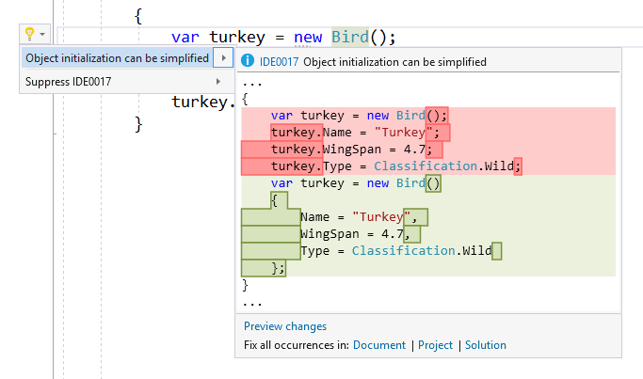

IDE0017 – Object Initialization
Simplify object initialization with an initializer
Cons > AnimalFactory.cs
Notes:
https://www.visualstudio.com/en-us/news/releasenotes/vs2017-relnotes

Slide 83
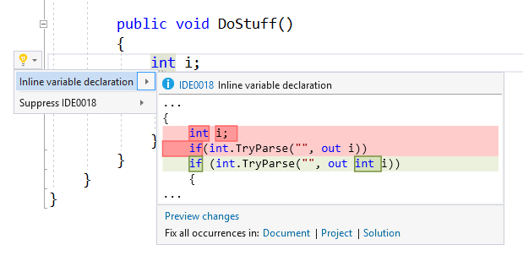
IDE0018 – out var
Move out vars inline using new c#7
Cons > AnimalFactory.cs
Notes:
https://www.visualstudio.com/en-us/news/releasenotes/vs2017-relnotes

Slide 84
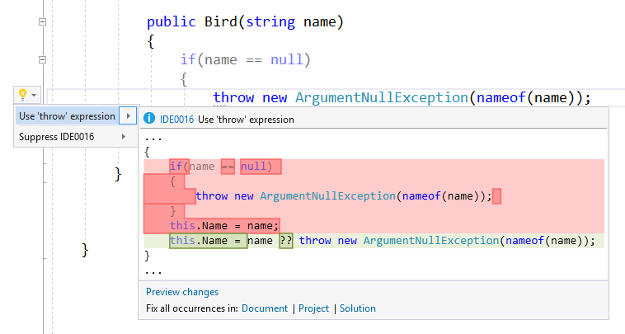
IDE0016 – Simplify nul lchecks
Simplify null checks with null coalescing
Cons > Bird.cs
Notes:
https://www.visualstudio.com/en-us/news/releasenotes/vs2017-relnotes

Slide 85
Q&A
Code snippets at https://github.com/jhealy/RoslynAnalyzerProofs

